Slide 1
Unit4
Storage Devices

Slide 2
Storage solutions that are currently available in computer world, are of different types and these vary from Direct Attached Storage (DAS) solutions to Network Attached Storage (NAS) solutions.
Use of disaster recovery methods and business continuity planning has boosted the demand for better and reliable storage solutions.
Storage used with the computer systems can be either internal storage or external storage type.

Slide 3
The most common internal storage used in the computer systems is the hard disk which is also known as fixed disk.
Hard disks store data on magnet-coated surfaces in the form of magnetic patterns.
Commonly used external storage devices include hard disks, DVD, magnetic tape, flash drive, etc.
External storage devices are connected to the computers through USB, FireWire or other interfaces.

Slide 4
Data transfer to external hard disks is faster than data transfer to the optical devices.
External hard disks are reliable and cheaper.
Optical storage has become a common storage technology in the recent years.
This technology makes use of laser beams for storing data and files in the medium.

Slide 5
CD, DVD, Blu-ray are the examples of storage devices that are using optical storage technology.
Storage devices are available with different storage capacities.
A large storage means more applications and files can be stored in it. Capacity of the modern hard disks is measured in higher units such as gigabytes (GB), terabytes (TB), etc.

Slide 6
. The total capacity of disk can be calculated when the details of tracks and sectors are known. The storage capacity is calculated using the following equation:
Storage capacity = Number of sides * Heads * Surface * Number of tracks * Number of sectors * 512 bytes.

Slide 7
Example
Consider a disk pack with the following specifications-
16 surfaces,
128 tracks per surface,
256 sectors per track and 512 bytes per sector.
What is the capacity of disk pack?

Slide 8
Solution-
Number of surfaces = 16
Number of tracks per surface = 128
Number of sectors per track = 256
Number of bytes per sector = 512 bytes
Capacity of disk pack
= Total number of surfaces x Number of tracks per surface x Number of sectors per track x Number of bytes per sector
= 16 x 128 x 256 x 512 bytes = 228 bytes
= 256 MB

Slide 9
Flash memory devices
A flash memory device contains trillions of interconnected flash memory cells that store data.
These cells hold millions of transistors that when switched on or off represent 1s and 0s in binary code, allowing a computer to read and write information.

Slide 10
One of the most recognizable type of flash memory device is the USB flash drive.
These days, a USB flash drive can hold up to 2 TB of storage.
They’re more expensive per gigabyte than an external hard drive, but they have prevailed as a simple, convenient solution for storing and transferring smaller files.
Aside from USB drives, flash memory devices also include SD and memory cards, which is a storage medium used in digital cameras.

Slide 11
Optical Storage Devices
CDs, DVDs, and Blu-Ray discs are Collectively known as optical storage devices or optical media.
Binary code is stored on these disks in the form of minuscule bumps along a track that spirals outwards from the center of the disk.
When the disk is in operation it spins at a constant speed, while a laser contained within the disk drive scans the bumps on the disk.

Slide 12
The way the laser reflects or bounces off a bump determines whether it represents a 0 or 1 in binary.
A DVD has a tighter spiral track than a CD, allowing it to store more data despite being the same size, and a finer red laser is used in DVD drives than CD drives.
DVDs also allow dual layering to increase their capacity further.
Blu-Ray store data on multiple layers with even smaller bumps that require an even finer blue laser to read them.

Slide 13
CD-ROM, DVD-ROM, and BD-ROM refer to read-only optical storage disks.
The data written on them is permanent and cannot be removed or overwritten.
This is why they can't be used as a personal storage. Instead, they are typically used for software installation programs.

Slide 14
CD-R, DVD-R, and BD-R format disks are recordable, but cannot be overwritten.
Whatever data you save on a blank recordable disk will then be permanently stored on that disk.
So, they can store data, but they’re not quite as flexible as other storage devices.

Slide 15
CD-RW, DVD-RW, and BD-RE are re-writable. This allows you can to write new data on them and erase unwanted data from them as much as you want.
They’ve been overtaken by newer technology like flash memory, but CD-RWs were once the top choice for external storage.
Most desktop computers and many laptops have a CD or DVD drive.
CD can store up to 700 MB of data, DVD-DL can store up to 8.5 GB, and Blu-Ray can store between 25 and 128 GB of data.

Slide 16
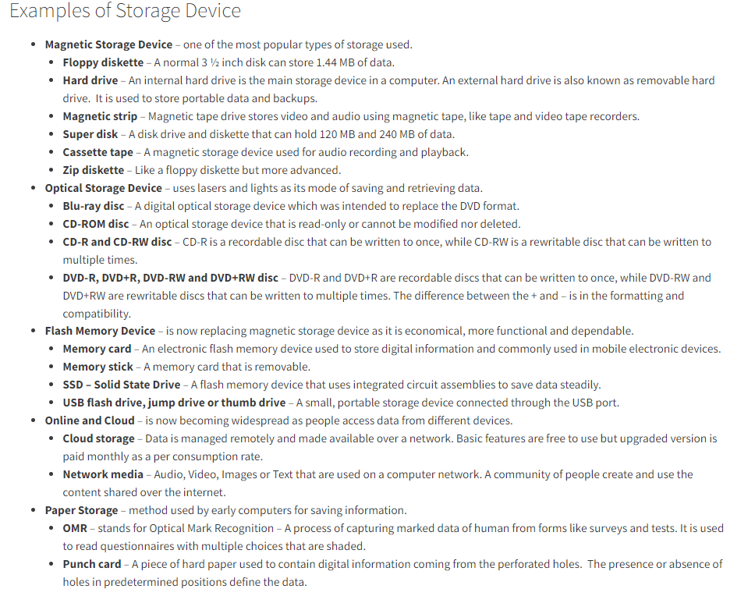

Slide 17
